Slide 1






THE ONLINE MOTORCYCLE SYSTERM
Group members:
1.Hà Tấn Thọ 20110431
2.Huỳnh ĐìnhThịnh 20110404

Slide 2



Contents
I. FUNCTION OF WEBSITE
II. BACK-END DESIGN
III. Planing completion
IV. DEMO

Slide 3

I. FUNCTION OF WEBSITE

Slide 4
Includes 8 main functions
1
2
3
4
5
Login: Delegating admin and user rights when logging in, the function of registering an account and forgetting the password.p.
Display: List of products and news for customers to view and select by category.
Add to cart: Customers who want to buy products must create an account and log in.
User management: Allow to register new users, or delete users when no longer using the service.
Product management: Check the quantity of each product and all information about that product. Edit and update specific prices for products on sale.

Slide 5
6
7
8
Allows invoicing, knowing the invoice date and the total amount to be paid for the invoice (admin and user).
Search function by product name, product type.
Print invoice to PDF file.

Slide 6
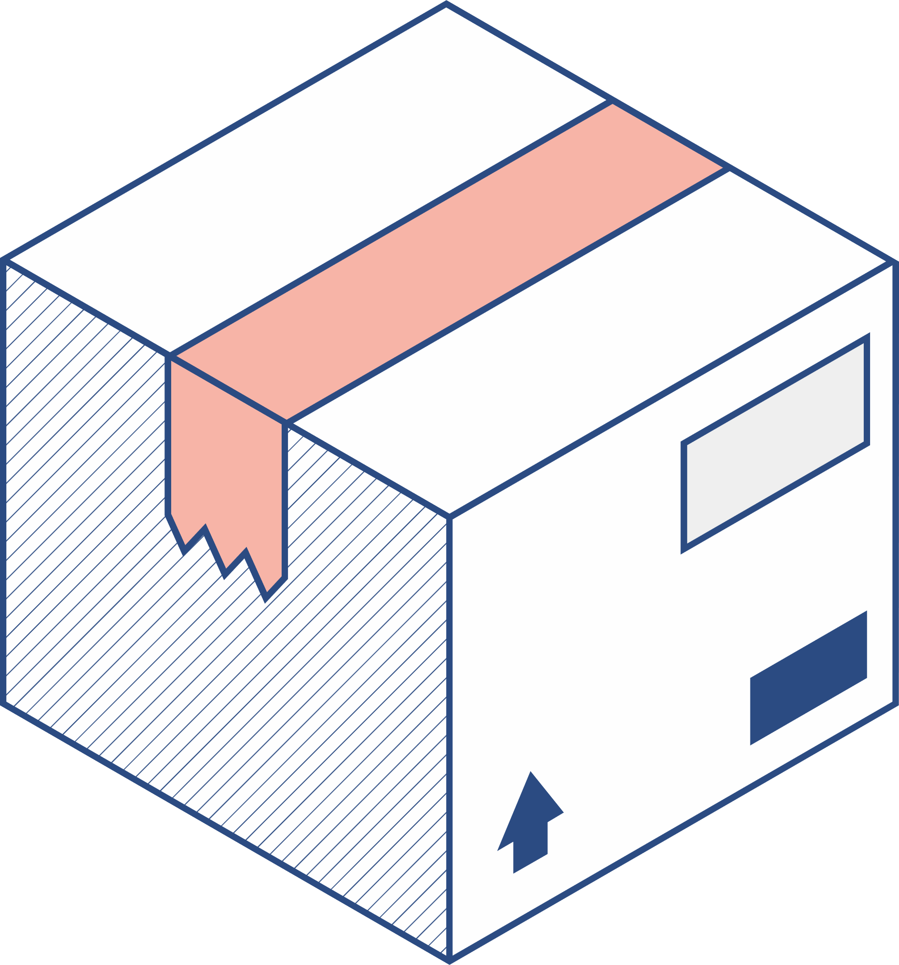


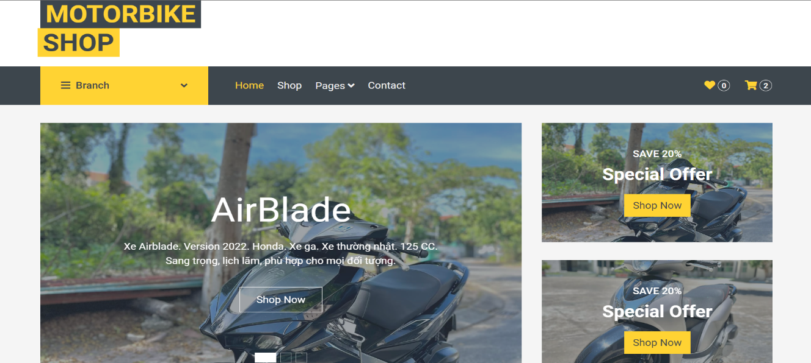
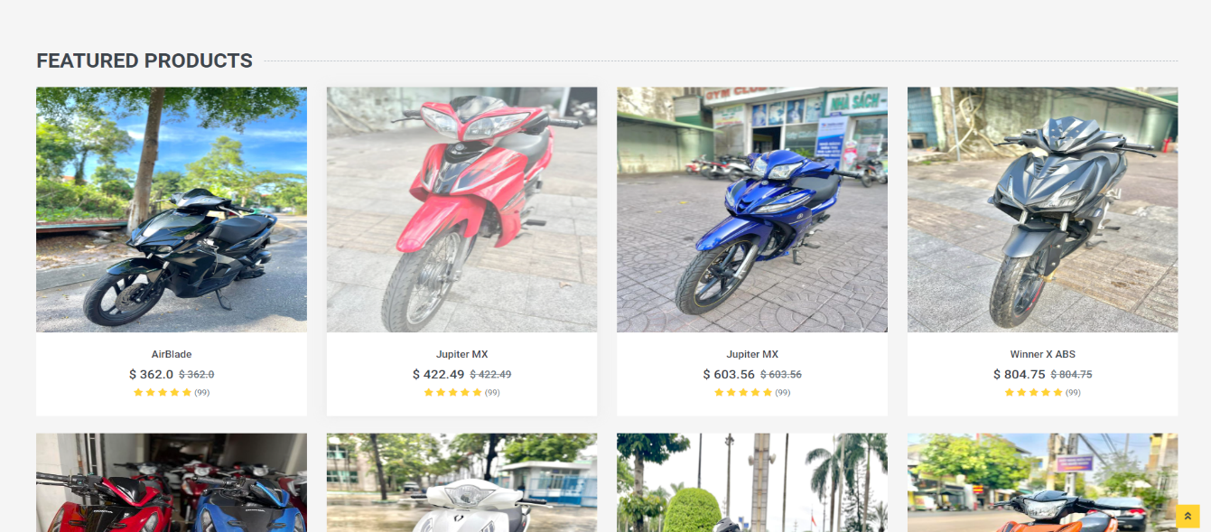

2. External function
Comment
Statistic
Payment method
Reviews from buyers
Contact
Filter
Role

Slide 7

II. Back-end design

Slide 8
Directory structure
API /Controller :
The API is actually just a controller, but its functions and tasks of adding, deleting, and editing will be done by separate functions.
Service layer
There are 2 components, the interface and the class that implements that interface. The reason for including 2 components is because it is necessary to ensure the D property in SOLID.

Slide 9





DAO layer:
There are 2 components, the interface and the class that implements that interface. In the interface there will be a parent interface GenericDAO that declares common functions for the DAO layer such as query

Slide 10
III. Planning completion

Slide 11
No | Goal | Schedule |  |  |  |  |  |  |  |  |  | Tho | Thinh
1 | Understand & describe the requirements of the project. | B | C |  |  |  |  |  |  |  |  | ✓ | ✓
2 | Learn & study Java properties, language related to project. | B | M | M |  |  |  |  |  |  |  | ✓ | ✓
3 | Identify the functions to be used in the software. | B | M | M |  |  | C |  |  |  |  | ✓ | ✓
4 | Building & design front-end architecture. | B | M | C |  |  |  |  |  |  |  | ✓ | ✓
5 | Building & design back-end architecture. |  |  | B |  |  | M | C |  |  |  | ✓ | ✓
6 | Testing the software. |  |  |  |  |  |  | B | M |  | C |  | ✓
7 | Write report. |  |  |  |  |  |  | B | M |  | C | ✓ | ✓
Week |  | 1 | 2 | 3 |  | 4 |  | 5 | 6 |  | 7
Note |  | B – Begin |  |  | M – Complete 50% |  |  |  |  | C – Complete 100%

Slide 12


IV. Demo

Slide 13


Slide 14



THANKS FOR
WATCHING!

